Slide 1
Little India in Toronto
Coursera Data Science Capstone

Slide 2
INDEX
Introduction
Toronto Background
Findings
Recommendations
Conclusion

Slide 3
Introduction

Slide 4
Introduction
The purpose of this project is to help investors establish which neighbourhood in Toronto would be the best to open an Indian restaurant.
The main Question to answer is “which place/s would be the most ideal to open an Indian restaurant”

Slide 5
Toronto Backgrounnd

Slide 6
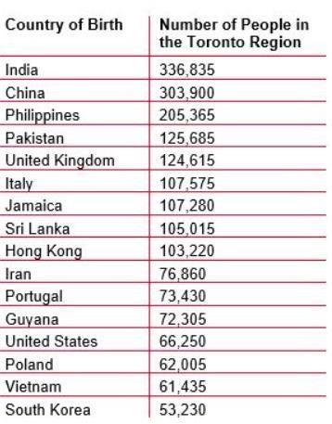
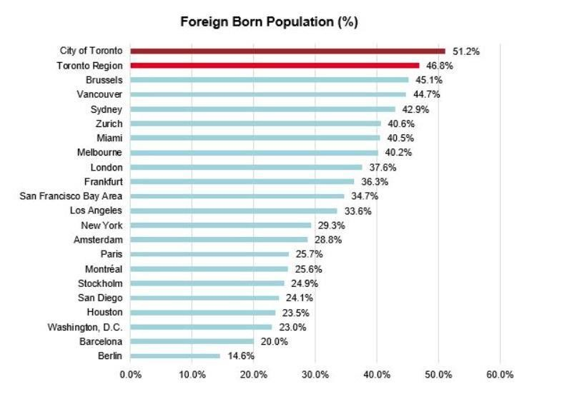
Toronto Background
For one thing, the proportion of our population that’s foreign born remains higher than just about any major city in the world. In the City of Toronto, 51% of residents were not born in Canada and for the Toronto Region as a whole, that figure is 47%. This is higher than any other metro region in North America, and higher than Greater
London, Sydney, Melbourne, Paris, and Amsterdam (see figure below). The only
North American cities with higher foreign born rates than Toronto are the Cities of Miami and Miami Beach. Yet unlike the Toronto Region, where just about every corner of the world is represented, more than three quarters of immigrants in Miami hail from Latin America.

Slide 7
Findings

Slide 8
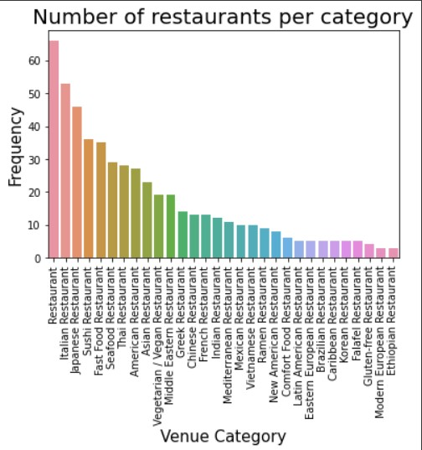
Findings
We sampled the top 30 most popular restaurants types to visualize the most popular restaurants, relative to the Indian restaurant. The Indian restaurant ranked 14th. The chart below visualizes the results.

Slide 9
Continued
When grouped into 3 k-clusters, Indian restaurants appeared in the 10 most popular venues list in the following boroughs:
East York
Scarborough (Most Frequent)
Central Toronto

Slide 10
Recommendations

Slide 11
Recommendations
The frequently appearing neighbourhood was Scarborough. There is an opportunity for the investor open the restaurant anywhere and leverage on having no competition in a neighbourhood.
It may also be safer to open the restaurant where people are already familiar with the Indian cuisine. Because the investors have little experience with the market, I would recommend that they open the restaurant in either Central Toronto or East York
This recommendation is due to the fact that even though there are some Indian Restaurants in these neighbourhoods, the competition would be less than that of as in Scarborough.

Slide 12
Conclusion

Slide 13
Conclusion
The purpose of this project was to find out the most ideal place to open an Indian restaurant. We processed the data and analysed it for further insights.
We identified the most popular restaurants per cluster in search of an ideal location and to ultimately answer the question “which place/s would be the most ideal to open an Indian restaurant?”.
The ultimate decision lies with the investor, after considering all factors

